Slide 2
Structure
Pre-work
Course 1
Course 2

Slide 3
Pre-work
Calculus : “Essence of calculus” by 3Blue1Brown
Linear algebra : “Essence of linear algebra” by 3Blue1Brown
3Blue1Brown web-link : https://www.3blue1brown.com/
It’s a beautiful resource.
Python cheat-shit: https://gto76.github.io/python-cheatsheet/
Cheat-sheet link : https://ml-cheatsheet.readthedocs.io/en/latest/#
Edx course : https://courses.edx.org/courses/course-v1:Microsoft+DAT256x+1T2019a/course/
(prereq: python knowledge)

Slide 4
Step - 1
Python revision form the udemy course
Another python course: https://github.com/microsoft/c9-python-getting-started
And
Math essentials from 3Blue1Brown: calculus and ML.
“Linear Algebra done right” – Downloaded.

Slide 5
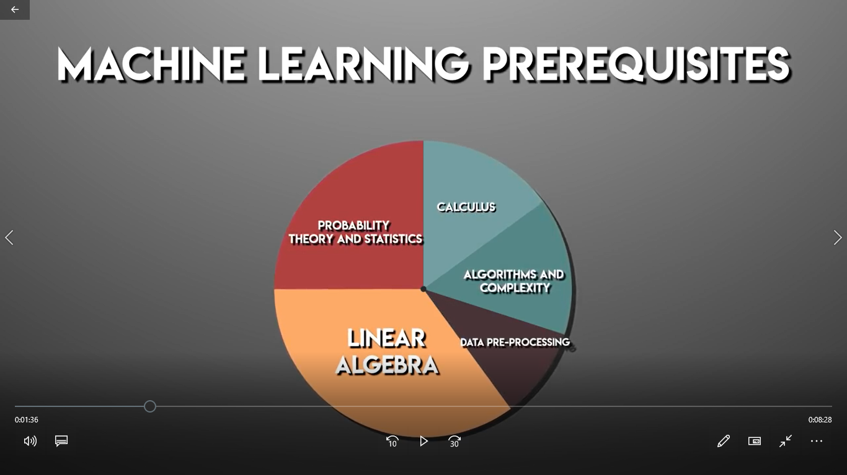
Probability and stat: done.
Calculus: 3blue1brown.
Algebra: 3blue1brown.

